Slide 1
Statistical Pattern Recognition
Bo Ma, Huijun Di
School of Computer Science
ajon@bit.edu.cn

Slide 2
Course Introduction
Course Description
Course Materials
Grading Policy
Syllabus

Slide 3
Course Description
Topics covered
Supervised learning
Generative/discriminative learning, regression, support vector machines, neural networks
Unsupervised learning
Density estimation, clustering, neural networks
Subspace learning
Probabilistic Graphical Models and Inference
Bayesian Network, MRF, HMM, CRF
BP, DP, EM, Variational method
Ensemble Learning
Boosting
Prerequisites
Knowledge of basic programing principles and skills
Familiarity with the basic probability theory
Familiarity with the basic linear algebra
Related disciplines:
Computer vision
Machine learning
Data mining

Slide 4
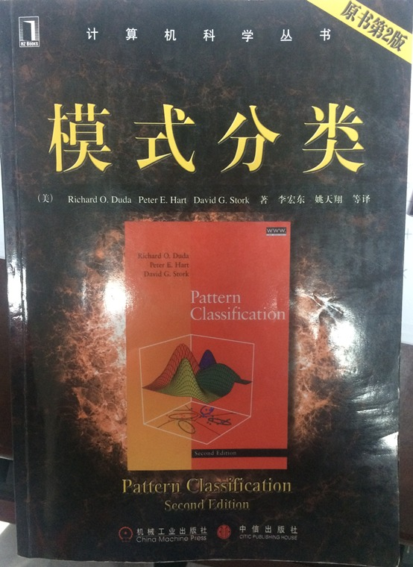
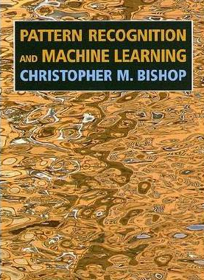
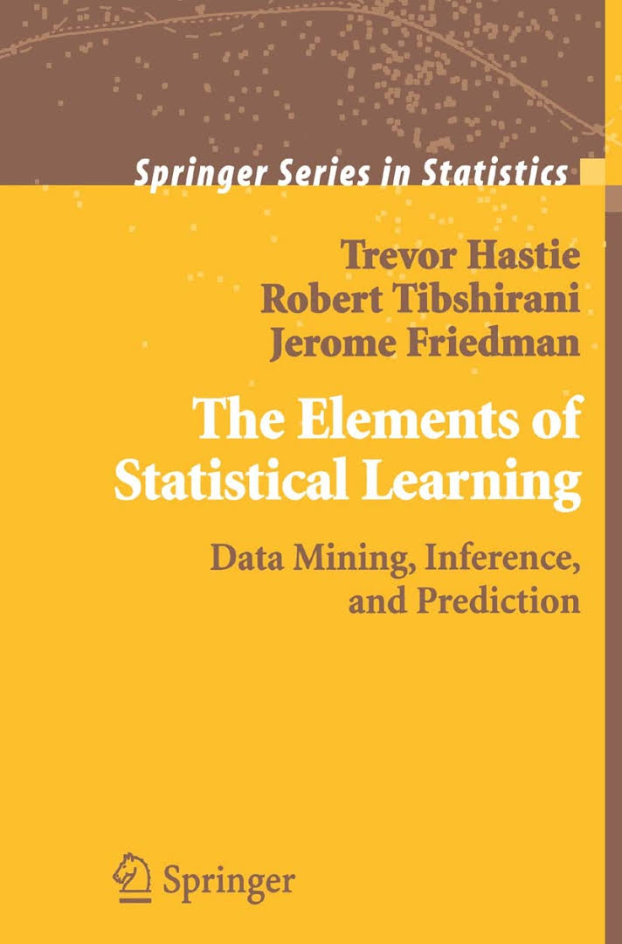
Course Materials
Textbook
Complementary Textbook

Slide 5


Course Materials
Reference Books: Machine Learning

Slide 6
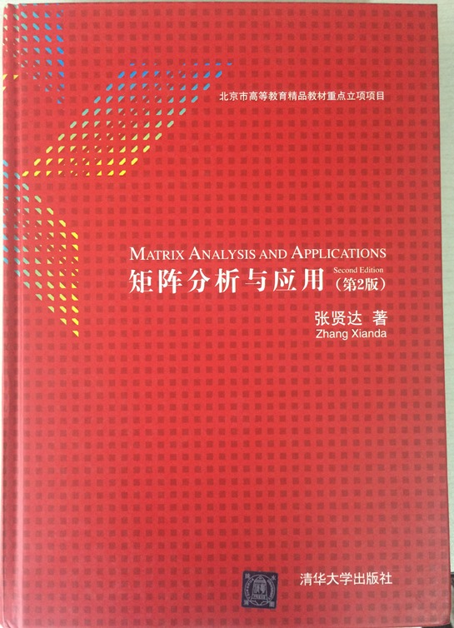
Course Materials
Reference Book: Matrix Analysis

Slide 7
Grading Policy
Homework: 10x2%
Project: 2x10%
Final Exam: 60%

Slide 8
Syllabus
Introduction (1)
Bayesian Decision Theory (0.5)
Parametric Density Estimation (1.5)
Non-parametric Density Estimation (1)
Clustering (1)
Subspace learning (3)
Classification (1)
Regression (1)
Probabilistic Graphical Models (2)
Inference (2)
Ensemble Learning (1)
Deep Learning (1)

Slide 9
Introduction (1)
Bayesian Decision Theory (0.5)
Parametric Density Estimation (1.5)
Parameter Estimation
Mixture models and EM
Non-parametric Density Estimation (1)
KNN, KDE
Clustering (1)
K-means, DBSCAN, Spectral Clustering
Subspace learning (3)
PCA, Kernel PCA, ISOMAP, LLE, LDA
Classification (1)
SVM
Regression (1)
Linear regression, Regularization
Logistic regression, Robust regression, SVR
Probabilistic Graphical Models (2)
Bayesian Network, MRF, HMM, DBN, CRF, Topic Models
Inference (2)
BP, DP, Variational method(EM, Mean field, …)
Ensemble Learning (1)
Deep Learning (1)

